Slide 1
Yoga Posture Recognition
Melita Madhurza, Caleb Kim, Minji Woo

Slide 2
Description
With the growing popularity of home yoga, maintaining precise postures is essential to prevent injuries and maximize effectiveness. However, beginners often lack expert guidance.
This project aims to develop a yoga posture recognition model that can classify eight yoga poses from the static images. The long term goal is to extend this model for real time feedback and posture correction, helping users improve their alignment. The selected postures focus on back pain prevention and posture correction.

Slide 3
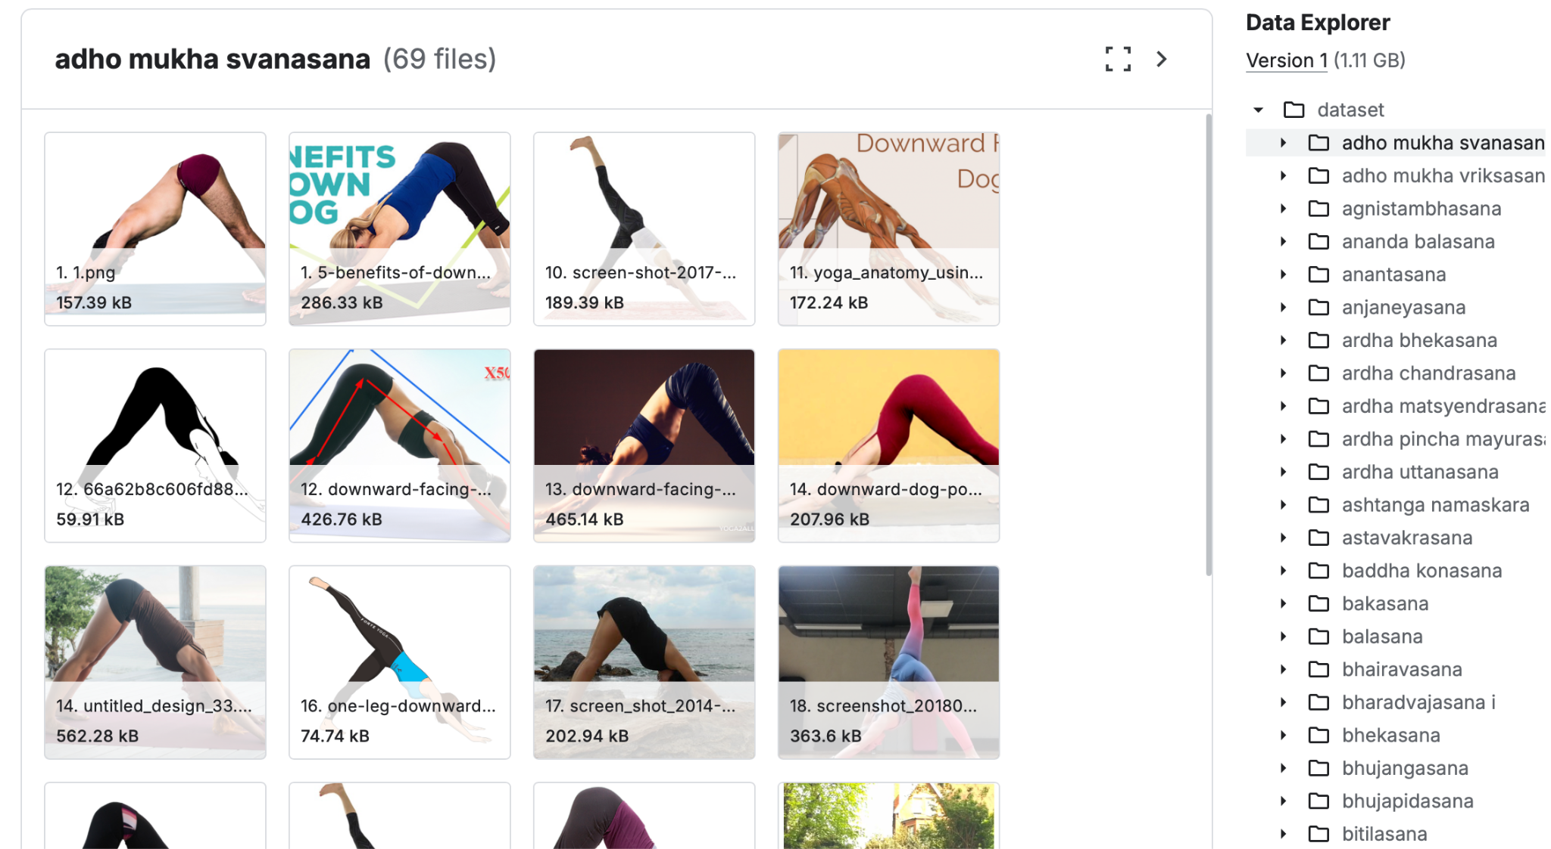
Dataset
Possible datasets used:
Yoga Poses Dataset
Yoga Poses Image Classification Set
Tools/Methods:
Eight yoga exercises will be selected to train our model
Blazepose model and a simple neuron network

Slide 4
Expected Outcomes
A deep learning model that accurately classifies up to eight yoga poses.
Recognizes yoga pose from images with varying body types, genders, camera angles, and lighting.
The model should recognize poses even when done slightly inaccurately or performed with minor adjustments.

